Slide 1


Measuring Components
Part 2
Common Mode Chokes
Dr. Norbert Doerry
Dr. John Amy
http://doerry.org/norbert/MarineElectricalPowerSystems/index.htm
© 2025 by Norbert Doerry and John Amy
This work is licensed via: CC BY 4.0 (https://creativecommons.org/)

Slide 2
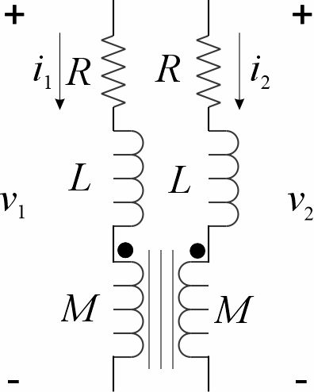
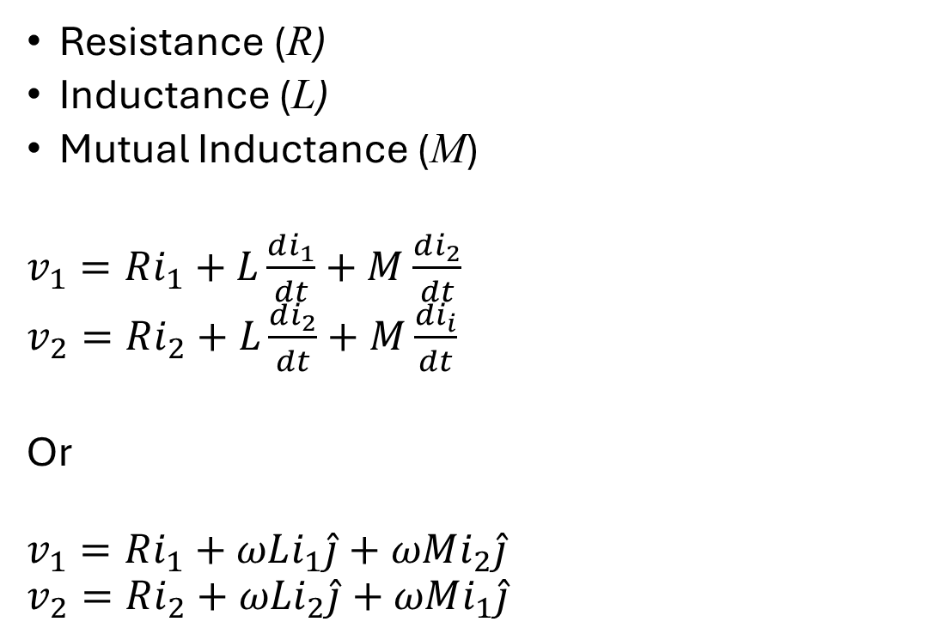
Physical Common Mode Chokes
Resistance (R)
Inductance (L)
Mutual Inductance (M)
$v_{1}=Ri_{1}+L\frac{di_{1}}{dt}+M$ $\frac{di_{2}}{dt}$
$v_{2}=Ri_{2}+L\frac{di_{2}}{dt}+M$ $\frac{di_{i}}{dt}$
Or
$$v_{1}=Ri_{1}+ωLi_{1}\hat{j}+ωMi_{2}\hat{j}$$
$$v_{2}=Ri_{2}+ωLi_{2}\hat{j}+ωMi_{1}\hat{j}$$

Slide 3
Resistance Measurement
Measure the DC resistance of each coil
  DC resistance depends on temperature of the wire
  Measured Values
    5 to 6: 2.2 ohms
    7 to 8: 2.6 ohms
AC resistance may be slightly larger, but can probably ignore difference
  AC losses in the inductor core

Slide 4
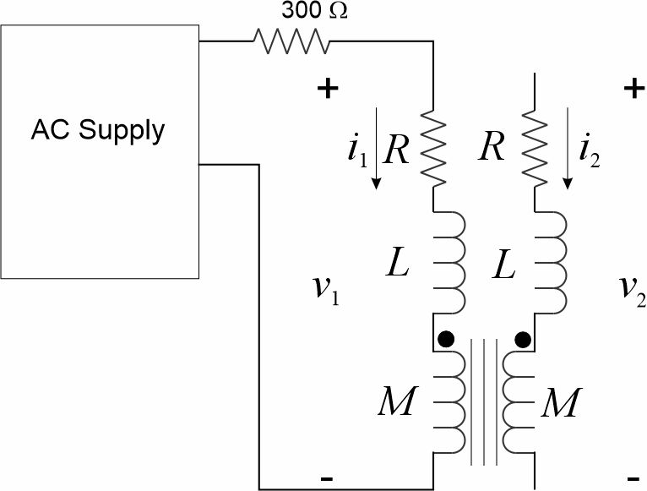

Inductance Measurement
$$\left|Z\right|=\frac{\left|v_{1}\right|}{\left|i_{1}\right|}$$
$${\left|Z\right|}^{2}=R^{2}+{\left(ωL\right)}^{2}$$
$$L=\frac{1}{ω}\sqrt{{\left|Z\right|}^{2}−R^{2}}$$

Slide 5

Mutual Inductance Measurement 1
$$v_{2}=ωMi_{1}\hat{j}$$
$$M=\frac{1}{ω}\frac{\left|v_{2}\right|}{\left|i_{1}\right|}$$

Slide 6
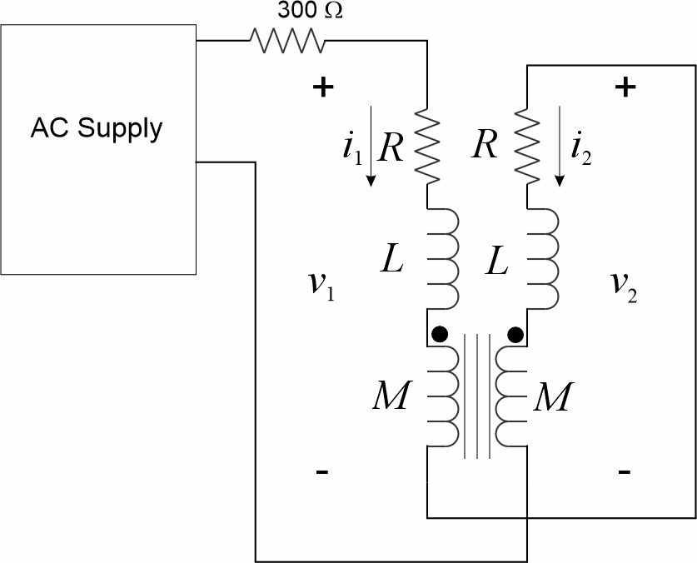

Mutual Inductance Measurement 2
$$\left|Z\right|=\frac{\left|v_{1}\right|}{\left|i_{1}\right|}$$
$${\left|Z\right|}^{2}=R^{2}+{\left(ωL+ωM\right)}^{2}$$
$$M=\frac{1}{ω}\sqrt{{\left|Z\right|}^{2}−R^{2}}−L$$

Slide 7
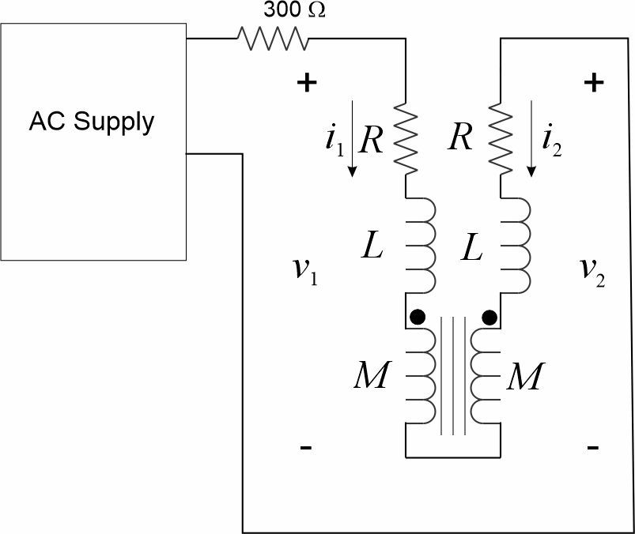
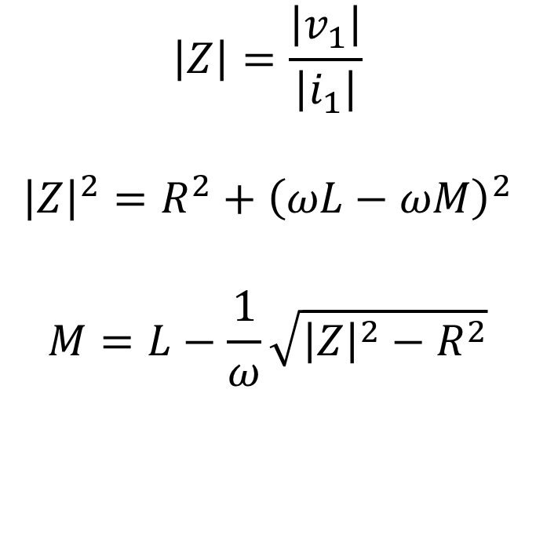
Mutual Inductance Measurement 3
$$\left|Z\right|=\frac{\left|v_{1}\right|}{\left|i_{1}\right|}$$
$${\left|Z\right|}^{2}=R^{2}+{\left(ωL−ωM\right)}^{2}$$
$$M=L−\frac{1}{ω}\sqrt{{\left|Z\right|}^{2}−R^{2}}$$

Slide 8
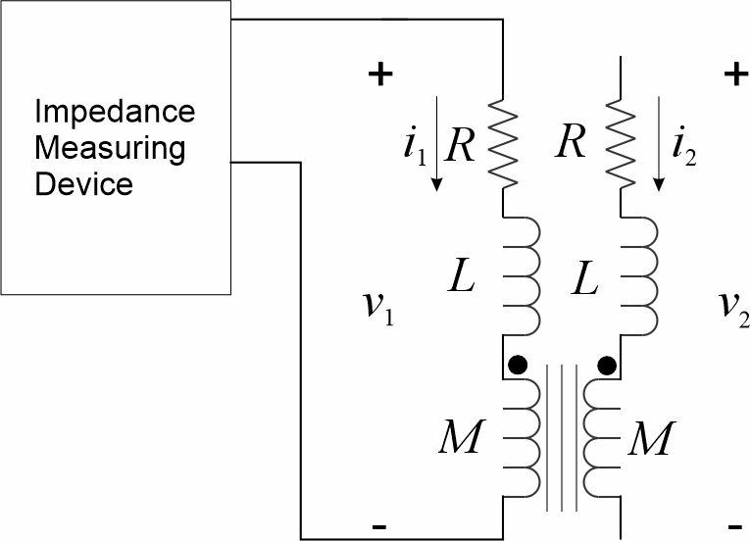
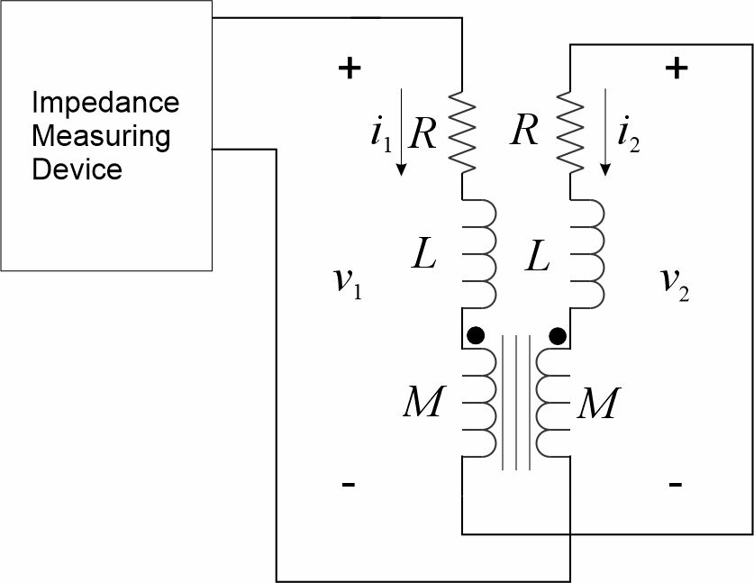
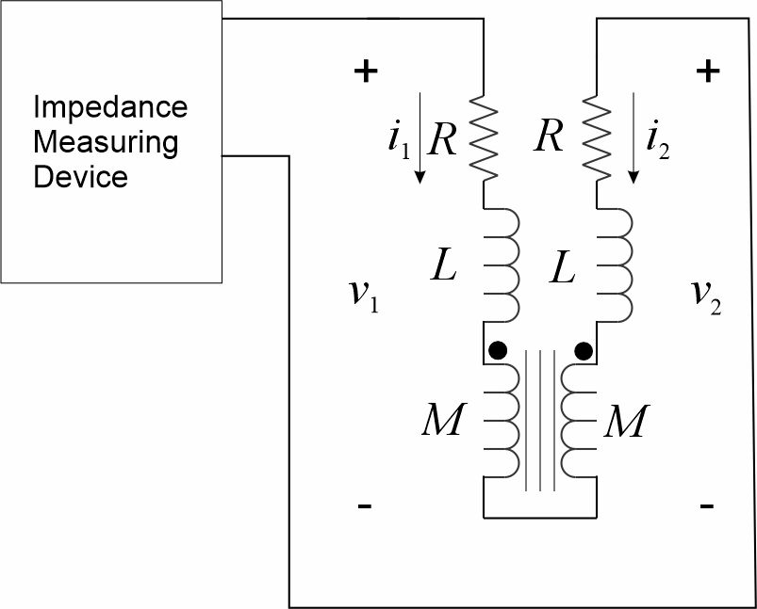
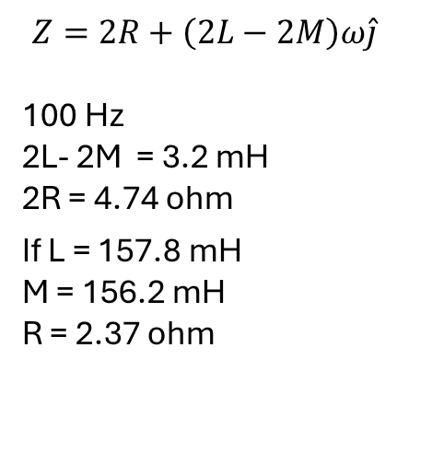
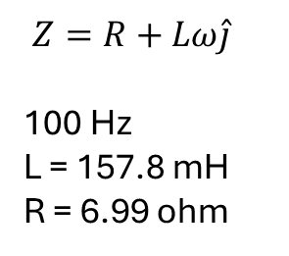
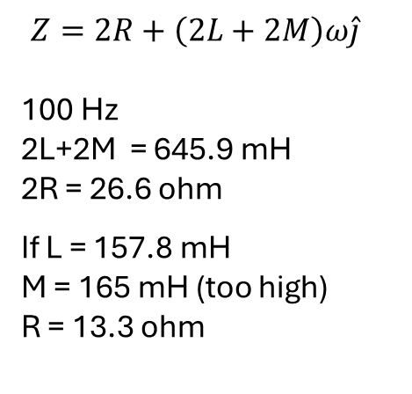
Direct Impedance Measurement
$$Z=2R+\left(2L+2M\right)ω\hat{j}$$
100 Hz
2L+2M = 645.9 mH
2R = 26.6 ohm
If L = 157.8 mH
M = 165 mH (too high)
R = 13.3 ohm
$$Z=2R+\left(2L−2M\right)ω\hat{j}$$
100 Hz
2L- 2M = 3.2 mH
2R = 4.74 ohm
If L = 157.8 mH
M = 156.2 mH
R = 2.37 ohm
$$Z=R+Lω\hat{j}$$
100 Hz
L = 157.8 mH
R = 6.99 ohm

Slide 9
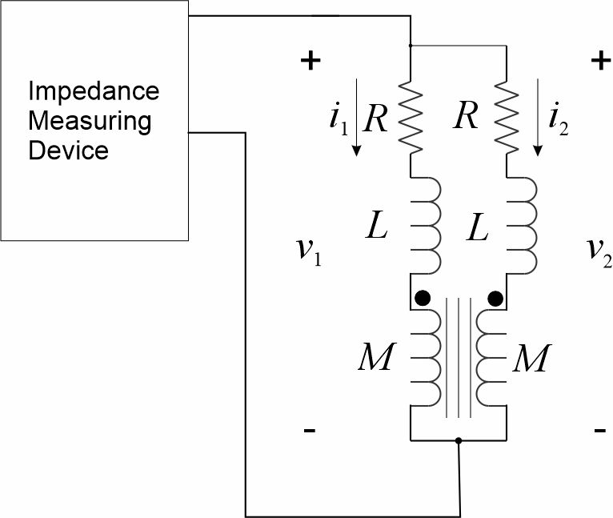
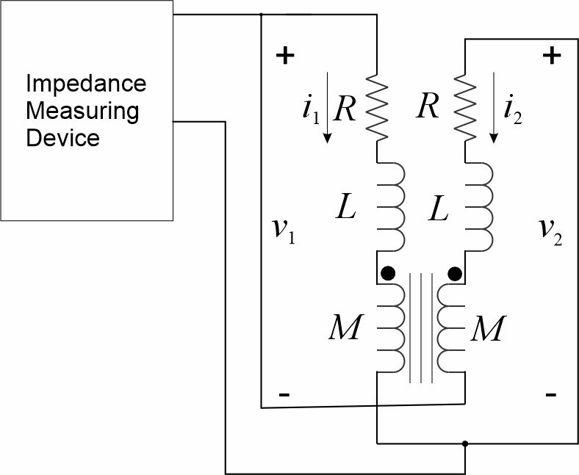
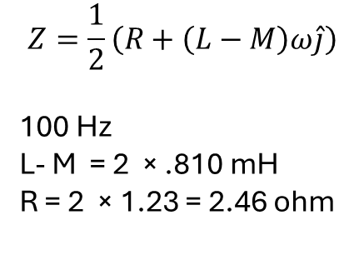
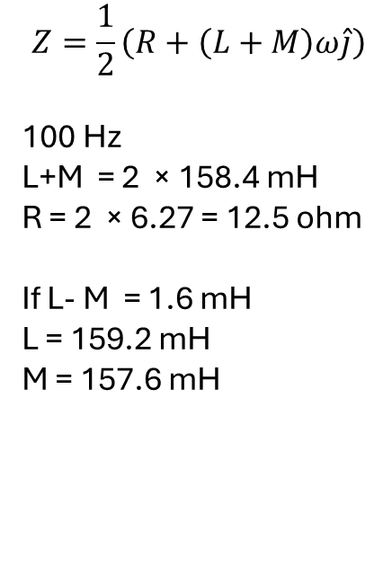
More Impedance Measurements
$$Z=\frac{1}{2}\left(R+\left(L+M\right)ω\hat{j}\right)$$
100 Hz
L+M = 2 × 158.4 mH
R = 2 × 6.27 = 12.5 ohm
If L- M = 1.6 mH
L = 159.2 mH
M = 157.6 mH
$$Z=\frac{1}{2}\left(R+\left(L−M\right)ω\hat{j}\right)$$
100 Hz
L- M = 2 × .810 mH
R = 2 × 1.23 = 2.46 ohm

Slide 10
Wrap up

